Slide 1



MARATHON ASSET MANAGEMENT
CORNELL CFEM CAPSTONE 2026
Marathon Project Meeting
Examining Data Centers and Further Sector Analysis
SPONSOR: Jason Foster
ADVISOR: Sasha Stoikov
TEAM: Alex Lee, Max Yap, Minxi Lin, Yung Lee, Olivia Mei
DATE: October 15, 2026

Slide 2
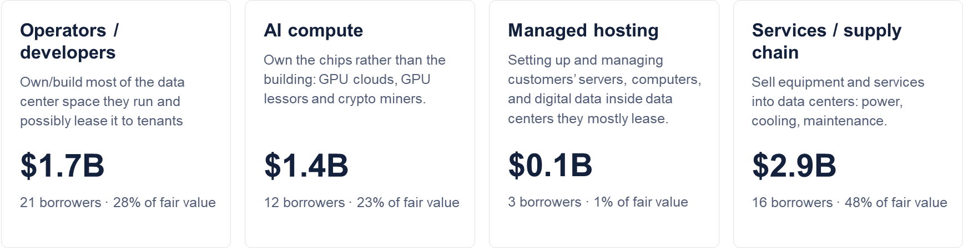
MARATHON ASSET MANAGEMENT
4 types of data-center-related borrower
CORNELL CFEM CAPSTONE 2026
We grouped 52 unique borrowers by what they do in the data center value chain. The first two are the core, and the last two are adjacent.
Fair value held by BDCs in 2026Q2
Source: BDC iXBRL filings. Borrowers identified primarily with Opus 5.5 (Extra Effort), cross-checked manually.

Slide 3
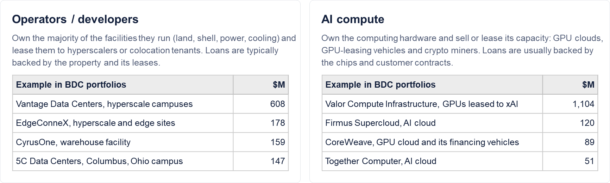
MARATHON ASSET MANAGEMENT
Core components: operators and AI compute
CORNELL CFEM CAPSTONE 2026
These borrowers own the capacity themselves, either the buildings or the chips.
Fair value held by BDCs in 2026Q2; largest four borrowers listed as examples per function.

Slide 4
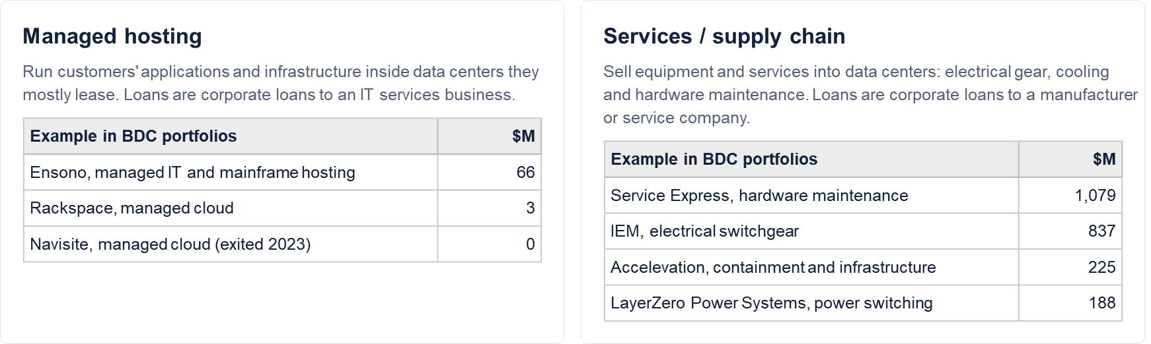
MARATHON ASSET MANAGEMENT
CORNELL CFEM CAPSTONE 2026
Ancillary components: hosting and supply chain
These borrowers depend on data centers for revenue but do not own the capacity.
Fair value held by BDCs in 2026Q2; largest four borrowers listed as examples per function.

Slide 5
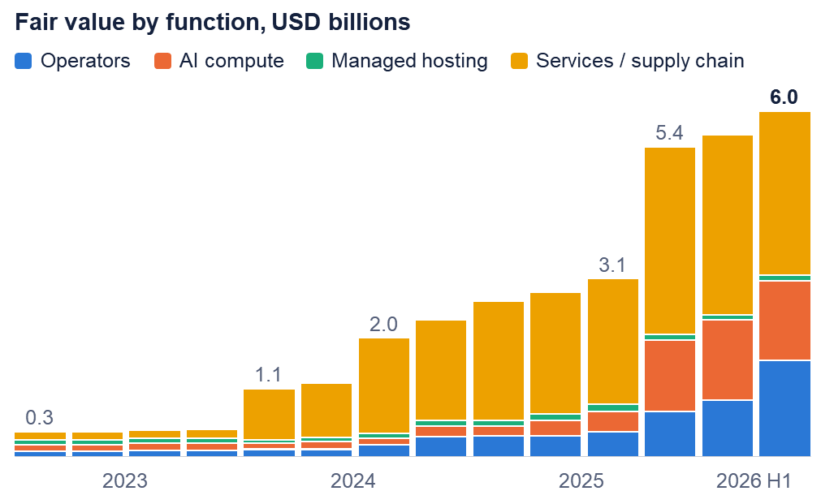
MARATHON ASSET MANAGEMENT
CORNELL CFEM CAPSTONE 2026
BDC lending to data-center-related borrowers
Fair value held grew from ~$0.3B in 2023Q1 to ~$6.0B in 2026Q2, approximately 1.1% of all BDC fair value.

Slide 6
MARATHON ASSET MANAGEMENT
CORNELL CFEM CAPSTONE 2026
Most exposed BDCs, 2026Q2
Largest by dollars | $M | % Total FV
Blackstone Private Credit | 1,043 | 1.3%
Apollo Debt Solutions | 786 | 3.1%
Ares Core Infrastructure | 574 | 25.8%
Ares Strategic Income | 401 | 1.9%
Ares Capital Corp | 326 | 1.3%
Most concentrated | $M | % Total FV
Ares Core Infrastructure | 574 | 25.8%
Great Elm Capital | 19 | 10.6%
Apollo Origination II (UL) | 57 | 8.2%
Apollo Origination II (L) | 133 | 8.2%
Sound Point Direct Lending | 25 | 7.3%
Apollo Origination II (L) and (UL) are the levered and unlevered versions of one strategy, $190M combined.

Slide 7
MARATHON ASSET MANAGEMENT
CORNELL CFEM CAPSTONE 2026
Sector coverage and the analysis sample
Coverage measures how much has a usable label within a specified sample.
Scope | Calculation | Current coverage
14-quarter numeric dataset | 403,787 / 502,299 records | 80.39% of records
2026Q2 first-lien baseline | $256.681bn / $291.918bn Cost | 87.93% of Cost
Full-data numerator: inherited team labels + retained development candidates.
Risk analysis: 24,186 holdings, 112 reporting CIKs. Unknown = 12.07% of Cost.
Reported-industry evidence and data-center flags remain separate.
The risk baseline keeps its existing labels. Candidate fills enter sensitivity checks.
1

Slide 8
MARATHON ASSET MANAGEMENT
CORNELL CFEM CAPSTONE 2026
Filing evidence: the TWAS example
Batch extraction: all source checks must pass
TWAS Holdings, 2026Q2 | Observed evidence
Old sector / issue | Unknown / heading on earlier page
Filing industry heading | Automobiles
Cost in filing | 110,195 × 10³ = $110.195m
Fair value in filing | $110.707m
Separate reported-sector output | Consumer, retained for development
1 Same holding
Date, context and full identifier agree.
2 Amounts agree
Cost, fair value and units match.
3 Bounded continuation
Same-date adjacent tables, matching columns.
4 Mapping accepted
Narrow crosswalk, no unresolved conflict.
Industry: table 10, row 48. Holding: table 12, row 20.
The continuation path through table 11 was checked
2

Slide 9
MARATHON ASSET MANAGEMENT
CORNELL CFEM CAPSTONE 2026
How the sector risk measures are calculated
Measure | Calculation | Technology example
Exposure share | Sector Cost / full-sample Cost | $71.871bn / $291.918bn = 24.62%
Net discount | 1 − sector FV / sector Cost | 1 − $70.202bn / $71.871bn = 2.32%
Low-valuation Cost share | Σ Cost for (FV/Cost < 0.90) ÷ Σ sector Cost | $3.579bn / $71.871bn = 4.98%
the dollar amounts first, then calculate each ratio
Screen: positive USD Cost, nonnegative USD FV, fixed first-lien candidate scope.
The 0.90 threshold is descriptive. Tail Cost is just exposure not the amount of loss.
2026Q2 holding-level first-lien screen. Existing sector/seniority labels. Borrower identities unverified.
3

Slide 10
MARATHON ASSET MANAGEMENT
Concentration
CORNELL CFEM CAPSTONE 2026
Share of the fixed sample’s $291.918bn Cost
Technology, Healthcare and Consumer combined is like 54.3%
12.07% of the sample is Unknown Cost
4

Slide 11
MARATHON ASSET MANAGEMENT
CORNELL CFEM CAPSTONE 2026
Healthcare’s tail share exceeds Technology’s
Technology + Healthcare: $7.14bn, or 51.12% of all low-valuation Cost.
Real Estate: 10.87% tail share, but only 1.02% of total Cost. Its ranking is label-sensitive.
5

Slide 12
MARATHON ASSET MANAGEMENT
CORNELL CFEM CAPSTONE 2026
PIK flags are associated with deeper marks
PIK flag: PIK text or a positive PIK rate. PIK means payment-in-kind interest.
10.40% of sample Cost
36.98% of all tail Cost
Healthcare tail share
All holdings | Without PIK flags
8.01% | 4.47%
The association warrants a sector × payment-structure comparison. It does not establish causality.
6

Slide 13
MARATHON ASSET MANAGEMENT
CORNELL CFEM CAPSTONE 2026
Validation and the scope of the conclusions
Check | Observed result | What it supports
Calculation reconciliation | Sector amounts add to the sample total Ratios recomputed independently in code | Arithmetic and aggregation consistency
Source-check pilot | 12/12 Cost/FV pairs match their source 9/12 have a clear reported-sector reference | Support for these sampled records
Frozen continuation template | Accepted 1 of 4 new cases The accepted case matches its sealed reference | Conservative output, with low pilot yield
References came from the same assistant’s source-first review.
Whole-dataset sector accuracy and legal borrower identities remain unverified.
Current use: preliminary exposure and valuation analysis, with Unknown and sensitivities visible.
12 previously unused name families: 6 random, 2 high-FV, 4 template cases. No validation labels deployed.
8

Slide 14
MARATHON ASSET MANAGEMENT
CORNELL CFEM CAPSTONE 2026
Sensitivity checks qualify the sector findings
Check | Observed result | Interpretation
Fill Unknown with direct reported-sector candidates | Top three exposures unchanged Max discount change: 0.069 pp | Stable concentration in the tested scenario.
Exclude 103 unresolved amount records | Pool discount: 1.65% to 1.57% Cost excluded: 0.094% | Amount issues affect close comparisons.
Revert six identity-sensitive labels to Unknown | Real Estate discount 2.47% to 3.28% Tail share 10.87% to 14.32% | Small-sector rankings are label-sensitive.
Concentration is relatively stable. Valuation rankings need qualification.
These are targeted scenarios, not error bounds. Exclusion scenarios recalculate their own denominators.
7

Slide 15
MARATHON ASSET MANAGEMENT
CORNELL CFEM CAPSTONE 2026
Borrower Name Cleaning
External Company Data Was Not Feasible
Attempted approach
Searched for a comprehensive list of U.S. companies and industry classifications
Public sources do not sufficiently cover private middle-market companies
Cornell’s Data Axle subscription provides Reference Solutions access, but not bulk API access
Commercial full-universe data was inaccessible or too expensive
No single source adequately covers BidCos, HoldCos, SPVs and private borrowers

Slide 16
MARATHON ASSET MANAGEMENT
CORNELL CFEM CAPSTONE 2026
Borrower Name Cleaning
Original pipeline + New pipeline
Original and new pipelines agreed on 201,194 names
Remaining 9,406 differences were reviewed using ChatGPT and Claude
Model outputs were mapped back using stable IDs, not row position
Random manual checks suggested that Claude was more reliable
Claude’s result was used when the two models differed
Compare cleaned names
Same
(201,194)
Different
(9,406)
Auto-accept
ChatGPT + Claude
Consensus (7,360)
Accept
Disagreement
(2,046)
Manual-check

Slide 17
MARATHON ASSET MANAGEMENT
CORNELL CFEM CAPSTONE 2026
Borrower Name Cleaning
Final Borrower-Name Decisions
210,395 names, or 99.90%, received a final decision
Claude resolved 9,201 of the 9,406 pipeline disagreements
Among Claude-resolved disagreements:
  80.7% retained the original result
  13.9% selected the V2 result
  5.4% required a new borrower name
Only 205 names remain for manual review
Decision source | Count | Share
Two pipelines agreement | 201,194 | 95.54%
Claude selected original pipeline result | 7,429 | 3.53%
Claude selected new pipeline result | 1,276 | 0.61%
Claude provided a new name | 496 | 0.24%
Unresolved / manual review | 205 | 0.10%

